Slide 1

COMP821 semester 1 2024
Session 4 Access Control

Slide 2
Orientation
This lecture is about :
Access control - what is it ?
Biometric authentication, including verification and identification.
PKI (cryptographic authentication)
Central authentication servers and directory servers
Identity management.

Slide 3
Access Control
Firms must limit access to physical and electronic resources. Access control is policy driven. It includes access to systems, data, and dialogues.
The AAA Security objectives
Authentication-supplicant sends credentials to verifier : the supplicant claims to be identity X, and sends credentials that authenticate the supplicant as identity X.
Authorization-what permissions the authenticated user will have
Auditing/accountability-recording what people do in log files
Seven Security Objectives: COA+AAA+non repudiation

Slide 4
Authentication
Credentials Are Based on
What you know (e.g., a password)
What you have (e.g., an access card)
What you are (e.g., your fingerprint)
What you do (e.g., speaking a passphrase)
Cryptography : Many access control tools use it for authentication
Two-Factor Authentication, Multifactor authentication
Can be defeated by a Trojan horse on the user’s PC, or by a man-in-the-middle attack (e.g., a fake website)

Slide 5
Types of Access Control MODels in the organization
Individual access control: bases access rules on individuals’ accounts
Mandatory access control (MAC)
No departmental or personal ability to alter access control rules set by one higher authority. Uses resource classification and personnel clearance levels
Discretionary access control (DAC) (ACL: ID + privileges)
Departmental or personal ability to alter access control rules set by several higher authorities
MAC gives stronger security but is very difficult to implement
Non-Discretionary
Role-based access control (RBAC)
READING
https://www.twingate.com/blog/other/access-control-models

Slide 6
Physical Access and Security
Physical Security Perimeter : Ideally, only a single point of entry, but with emergency exits
Physical entry controls: offices, rooms, and facilities
Protecting against external and environmental threats
Rules for working in secure areas
Public access, delivery, and loading areas
DAC< MAC< RBAC can be used in physical security as well: https://butterflymx.com/blog/access-control-models/
======Other models: RuBAC (rule based) , ARBAC (attribute based)--> for a comparison, read https://techgenix.com/5-access-control-types-comparison/

Slide 7
Passwords
Reusable password : Password used for weeks or months at a time
One-time password : Used only once
To make it hard to crack a password remotely, accounts are locked after a few login failures
Password-cracking programs ! Lists of common passwords, dictionary attacks!
Read more in Chapter 5
Password cracking: https://www.youtube.com/watch?v=_CwGYkxrP-k
https://resources.infosecinstitute.com/topics/hacking/crack-password-walkthrough/

Slide 8
Access Cards and Tokens
Access Cards : Magnetic stripe cards, Smart cards
In selection decision, must consider cost and availability of card readers
Tokens: Constantly changing password devices for one-time passwords (OTP)
USB plug-in tokens
Use Radio Frequency ID (RFID) technology: Supplicant only has to be near a door or computer to be recognized
Question: what kind of control is it when (after supplying your credentials) you are asked to confirm that is you who want to access a resource, by replying positively to the Duo question on your mobile ?
Negative and positive sides of the above control

Slide 9
Biometric Authentication (slides 9 to 17)
Authentication based on biological (bio) measurements (metrics)
https://www.youtube.com/watch?v=lPEd_pal8UY (What is biometrics)
Biometric Systems
--Enrollment (to obtain the biometric data, process for key features, to create a template, store in a databases
--Later access attempts - thse provide access data, that are turned into key feature data & compared to the template
--Biometric access key features will never be exactly the same as the template
There must be configurable decision criteria for deciding how close a match to require (match index)
Requiring an overly exact match index will cause false rejections
Requiring too loose a match index will cause false acceptances

Slide 10
Biometric Authentication Metrics
Fingerprint Recognition
Iris recognition
Face recognition
Hand geometry
Voice Recognition
Veins in the hand
Keystroke recognition (pace in typing password)
Signature recognition (hand-written signature)
Gait (way the person walks) recognition
Read Chapter 5 for more detailed descriptions

Slide 11
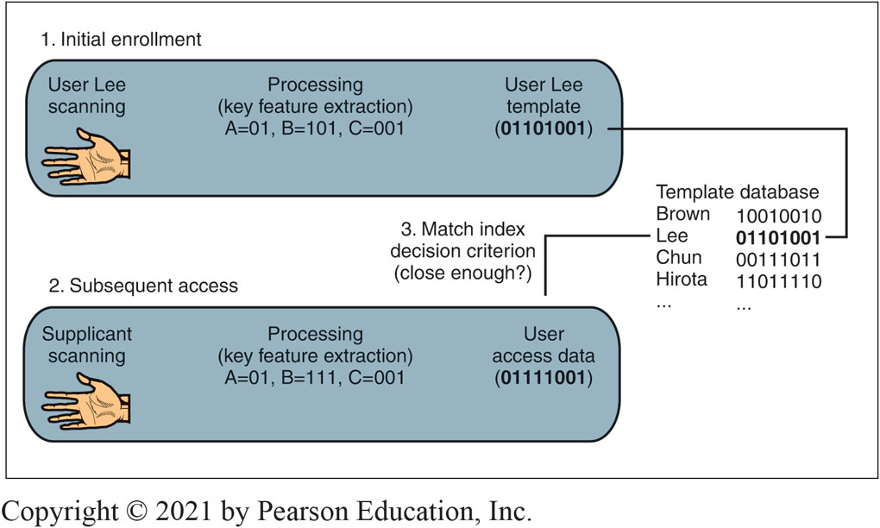
[Figure 5-10]: Biometric Authentication System
Notes:
This figure shows a biometric authentication system.

Slide 12
EFFECTIVENESS
Error rate : Refers to accuracy assuming the supplicant is not trying to deceive the system
Error rate metricss :Measures of accuracy assuming the supplicant is not trying to deceive the system
False Acceptance Rate (FAR) : Percentage of people who are identified or verified as matched to a template but should not have been (out of all attempted matches)
False Rejection Rate (FRR): Percentage of people who should be identified or verified as matches to a template but have been not (out of all attempted matches)
Equal error rate (EER) https://www.recogtech.com/en/knowledge-base/security-level-versus-user-convenience see next slide

Slide 13
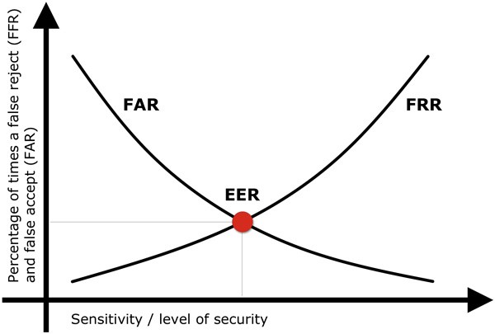
As the number of false acceptances (FAR) goes down, the number of false rejections (FRR) will go up and vice versa (see the figure below). The point at which the lines intersect also has a name: the Equal Error Rate (EER). This is where the percentage of false acceptances and false rejections is the same.
If you try to reduce the FAR to the lowest possible level, the FRR is likely to rise sharply. In other words, the more secure your access control, the less convenient it will be, as users are falsely rejected by the system.
The same also applies the other way round. Do you want to increase user convenience by reducing the FRR? In this case the system is likely to be less secure (higher FAR).

Slide 14
Effectiveness cont.
Vendor Claims for FAR and FRR: may exaggerated through tests under ideal conditions
Failure to Enroll (FTE): Subject cannot enroll in system (e.g., poor fingerprints , or deteriorating fingerprints) .
Deception rate: The likelihood that an impostor will be able to deceive the system if he or she tries. E.g., if the database contains the templates io legitimate users and the FAR is high
Many biometric methods are highly vulnerable to deception

Slide 15
Verification and identification
Supplicant claims to be a particular person . Is the supplicant who he or she claims to be?- Verification
The system must compare the access data as processed for key features) to one single template (the claimed identity)
--Verification is good to replace passwords in logins
Check this: if the probability of a false match is one in one thousand, then the verification FAR of this system is one in a thousand because only one match is attempted. I.e., FAR is 0.1 %
Supplicant does not state his or her identity but requires access: Should they be given access? Identification
The system must compare supplicant data to many (may be to all) templates in the database , searching for a match
Check this If the probability of a false match is the same a s above, i.e. ,1/1000 per attempted template match, and if there are 500 templates in the database, then the identification FAR is 500 * 1/1000 (50%)
--Identification is good for door access
Notes:
One In a thousand attempted matches, one will render a “yes, match” outcome but the outcome will be wrong as in fact this is it a true match

Slide 16
A More targeted identification: Watch lists
The supplicant claims identity X and provides credential but access is approved or denied if there is match to a template in the database of the watchlist
Normally watch list as are not huge , so the risk of false acceptance is intermediate
If the probability of a false acceptance (false match) is 1/1,000 per template match, and if there are 10 templates in the watch list, then the probability of a false acceptance is 10 * 1/1,000 (1%)
Can be used for border control where identities found in the watch list are NOT given access
What is the meaning of FAR in this case? Of FRR?
For border control, if a person G is falsely accepted (i.e., , the match attempt was successful) this means a major problem for H , as they may be a legitimate entrant – however the country security is not in jeopardy because of this false acceptance . However, if a person B is falsely rejected, they will enter the country but they may be on the list of undesirable persons!
Notes:
For border control, if a person H is falsely accepted (ire, the match attempt was successful) this means a problem, as they may be a legitimate entrant. Even worse , if they are falsely rejected, they will enter but they may be on the terrorist list!

Slide 17
Cryptographic Authentication (slides 17-19)
Key Points from previous lectures
Cryptographic systems include initial and message-by-message authentication. Initial authentication is a form of access control
MS-CHAP uses SHARED SCRET KNOWLEDGE (‘password’) for initial authentication (hashing is the method) (Microsoft Challenge Handshake Protocol)
Electronic signatures provide message-by-message authentication
Key-Hashed Message Authentication Codes (HMACs) are fast and inexpensive
Digital signatures with digital certificates are extremely strong but slow
Public key authentication with digital certificates is also good for initial authentication → PKI

Slide 18
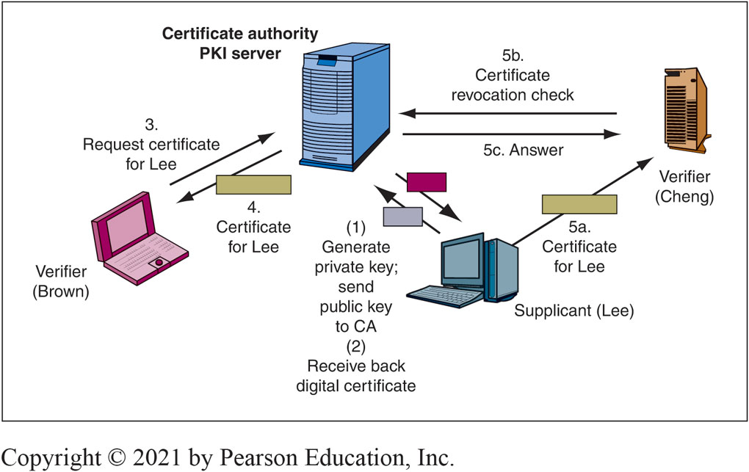
[Figure 5-18]: Functions of a Public Key Infrastructure (PKI)
Notes:
Figure 5-18 illustrates the functions of a PKI.

Slide 19
Public Key Infrastructure (PKI)
Enterprise PKI: Firms can be their own certificate authorities (CAs). Expensive, labour consuming .
What is provisioning ? → Giving the user access credentials
Human registration is often the weakest link
If an impostor is given credentials, no technology access controls will work
To control, Limit on who can submit names for registration
Limit who can authorize registration
Have rules for exceptions
Must have effective terminating procedures
Supervisors and Human Resources department must assist
New Challenges with IoT, mobile devices
Read: https://www.keyfactor.com/education-center/what-is-pki/
Watch : https://www.youtube.com/watch?v=0ctat6RBrFo

Slide 20
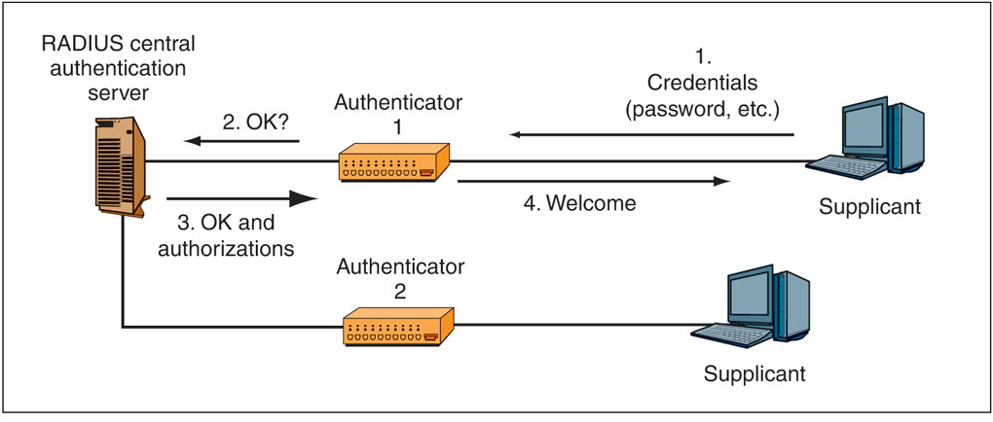
[Figure 5-21]: RADIUS Central Authentication Server
Notes:
The most widely used standard for central authentication servers is RADIUS. Figure 5-21 recaps the basic elements in RADIUS central authentication.

Slide 21
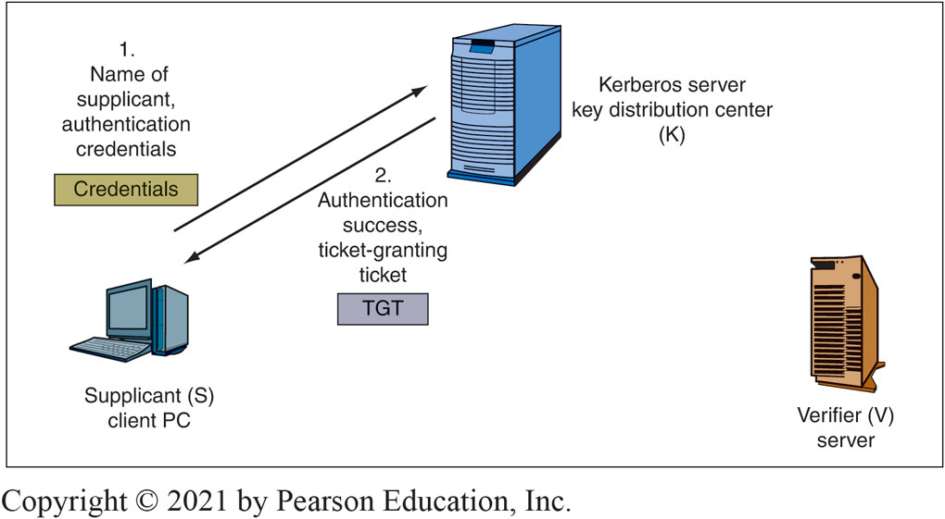
Figure 5-22: Kerberos Initial Login
Read : https://www.fortinet.com/resources/cyberglossary/kerberos-authentication#:~:text=A%20Kerberos%20is%20a%20system,web%20pages%20they%20visit%20online.
Notes:
Figure 5-22 shows that when a host wishes to connect to another host, it first logs into a Kerberos server. If it succeeds in logging in, it gets a ticket granting ticket (TGT). This is like getting a wrist bracelet when you enter a concert or sports event. It gets you back in later without having to show your original authentication credentials. Kerberos uses symmetric key cryptography and a key distribution center (KDC) to authenticate and verify user identities. A KDC involves three aspects:
A ticket-granting server (TGS) that connects the user with the service server (SS)
A Kerberos database that stores the password and identification of all verified users
An authentication server (AS) that performs the initial authentication
During authentication, Kerberos stores the specific ticket for each session on the end-user's device. Instead of a password, a Kerberos-aware service looks for this ticket. Kerberos authentication takes place in a Kerberos realm, an environment in which a KDC is authorized to authenticate a service, host, or user.
Kerberos authentication is a multistep process that consists of the following components:
The client who initiates the need for a service request on the user's behalf
The server, which hosts the service that the user needs access to
The AS, which performs client authentication. If authentication is successful, the client is issued a ticket-granting ticket (TGT) or user authentication token, which is proof that the client has been authenticated.
The KDC and its three components: the AS, the TGS, and the Kerberos database
The TGS application that issues service tickets

Slide 22
Directory Servers
Central repositories for information about people, equipment, software, and databases
Directory servers use a hierarchical database organization : the database schema is a hierarchical collection of objects (nodes)
Lightweight Directory Access Protocol (LDAP) : Used to retrieve data from the directory server

Slide 23
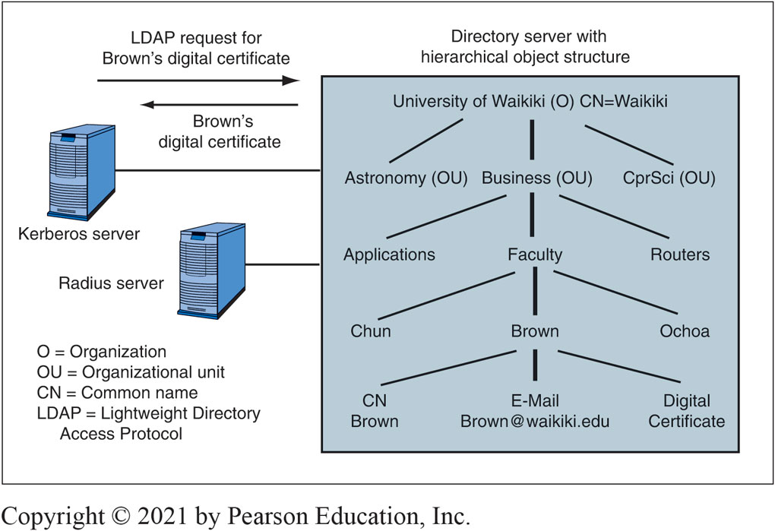
Figure 5-24: Directory Server Organization
Notes:
Directory servers use a hierarchical database organization. The directory server database schema is a hierarchical collection of objects (nodes).

Slide 24
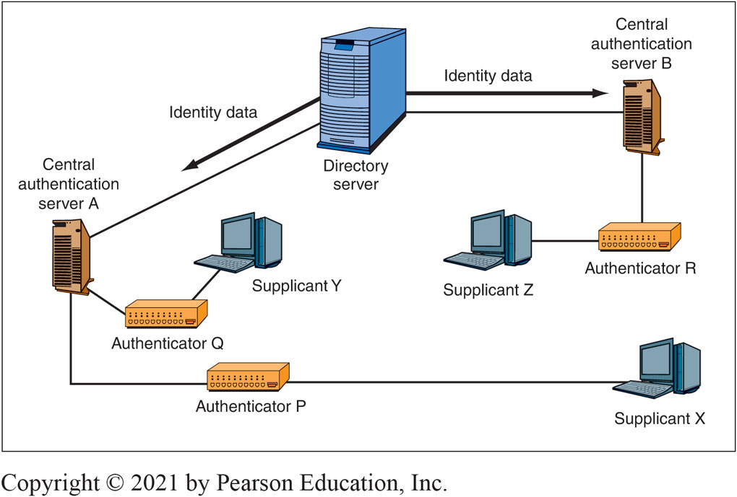
Figure 5-25 Using a Directory Server to Centralize Authentication Information
Notes:
As Figure 5-26, shows, companies usually divide their resources into multiple active directory domains.

Slide 25
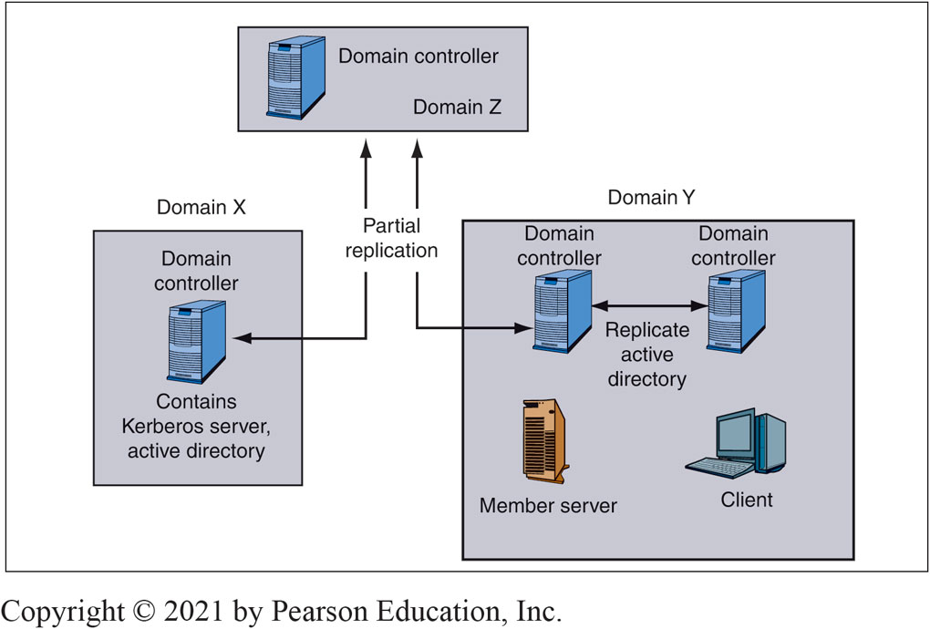
Figure 5-26: Active Directory Domains and Tree
Notes:
In Figure 5-26, Domain X has a single domain controller server, which controls the resources in the domain. The domain controller has both an active directory database and a Kerberos authentication server program. Consequently, it handles authentication and AD searches within the domain.

Slide 26
FULL Identity Management (slides 26-30)
Identity management is the centralized policy-based management of all information required for access to corporate systems by a person, machine, program, or other resource
Identity
The set of attributes about a person or nonhuman resource that must be revealed in a particular context
Principle of minimum identity data: only reveal the information necessary in a particular context
Watch https://www.youtube.com/watch?v=aNj36g7fSsU

Slide 27
Full Identity Management Cont.
Involves Trust : Means that one directory server will accept information from another
Mutual : Bidirectional
One-way: One directory server trusts another, but the trust is not reciprocated
Transitive: If Directory Server X trusts Directory Server Y, and if Directory Server Y trusts Server Z, then Directory Server X will automatically trust Directory Server Z
Intransitive: If Directory Server X trusts Directory Server Y, and Directory Server Y trusts Directory Server Z, but Directory Server X does not automatically trust Directory Server Z

Slide 28
BENEFITS OF Full Identity Management
Reduction in the redundant work needed to manage identity information
Consistency in information
Rapid changes
Central auditing
Single sign-on (SSO)
Increasingly required to meet compliance requirements
At least reduced sign-on when SSO is impossible
Watch https://www.youtube.com/watch?v=gsgdAyGhV0o

Slide 29
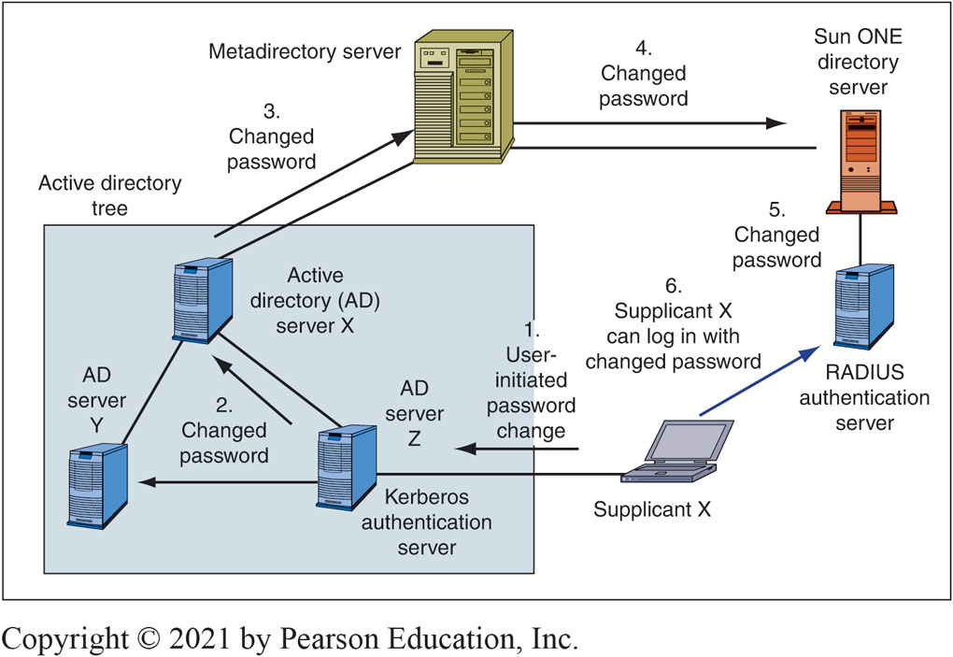
Figure 5-28: Multiple Directory Servers and Metadirectory Server
Notes:
In an ideal world, a company would only have a single family of directory servers. Instead, companies typically have several types of directory servers, as Figure 5-28 shows. Other common types of directory servers are Novell eDirectory and Sun ONE directory servers for Solaris (Sun’s version of Unix).
To connect these disparate directory servers together, the company in the figure has a metadirectory server. The metadirectory server gets the directory servers to exchange information and to synchronize services in a variety of ways. Unfortunately, these exchanges and synchronizations are limited today. Most commonly, when a user resets a password on one directory server, the metadirectory server passes the password reset to other directory servers.

Slide 30
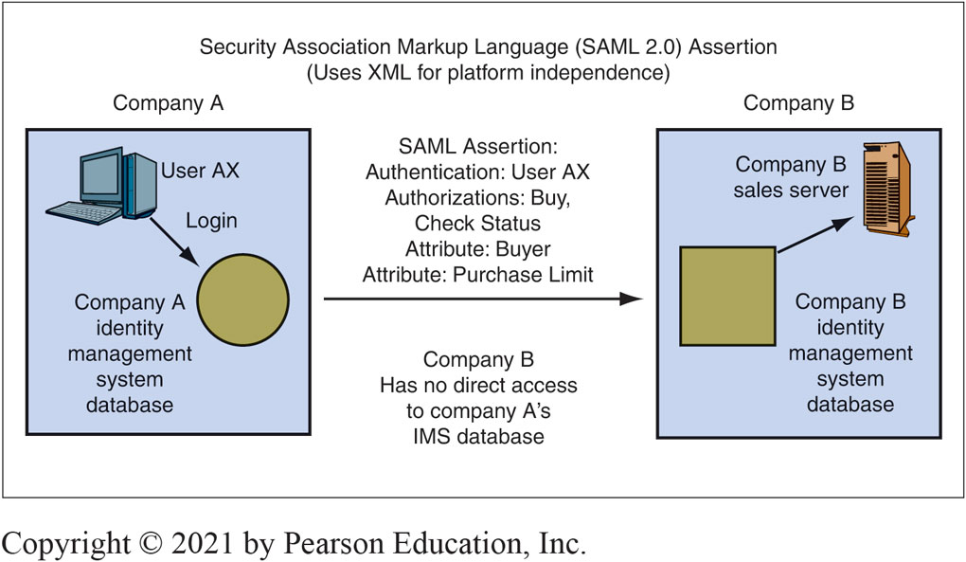
Figure 5-29: Federated Identity Management
Notes:
Within companies, trust is complex. The situation is even more complex between companies. Between companies, we talk about federated authentication, authorization, and auditing or, more commonly, federated identity management.21 Figure 5-29 illustrates federated identity management.

Slide 31
AuditinG
What the person actually did
Logging
Events: On a server, these refer to logins, failed login attempts, file deletions, and so forth. Events are stored in a log file
Log Reading
Regular log reading is crucial or the log becomes a useless write-only memory
Periodic external audits of log file entries and reading practices
Automatic alerts for strong threats
Industry demand for log analysts! Let us have a quick look at https://www.xenonstack.com/blog/log-analytics-deep-machine-learning

